Slide 1
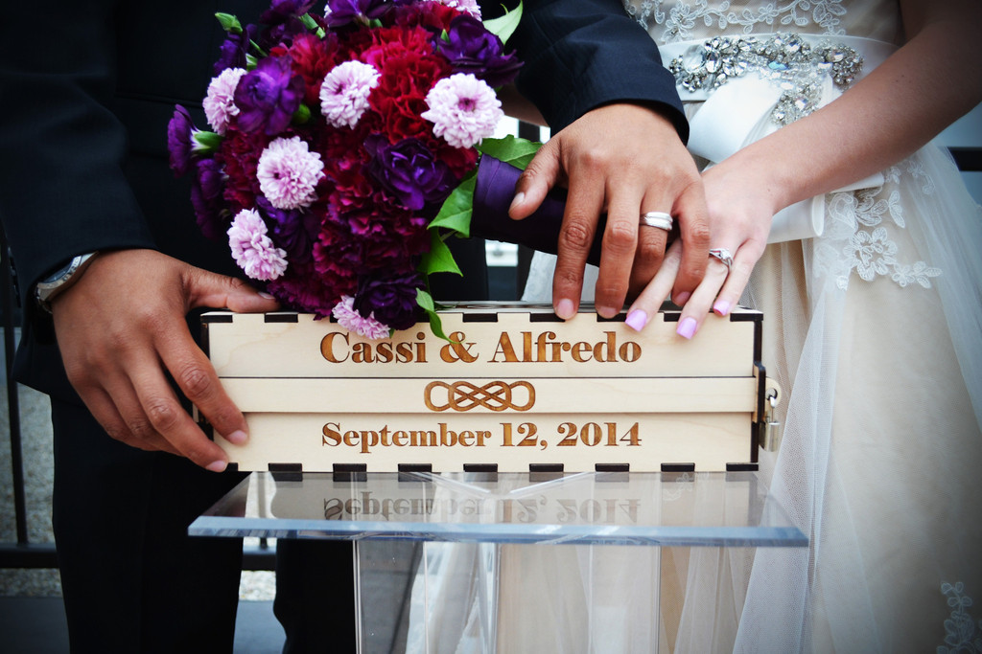

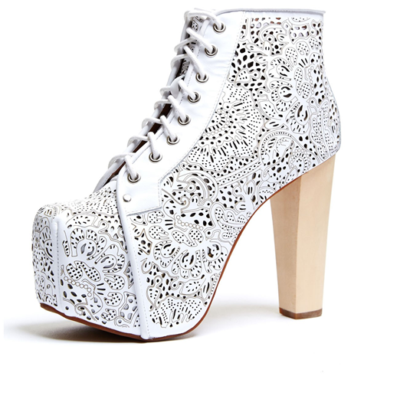

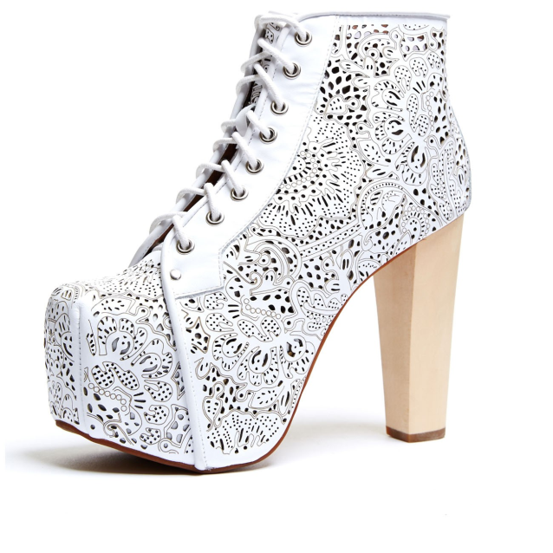

Starting a Business with a Laser Cutter
The beginner’s guide to starting a business focused on a laser cutter

Slide 2

Starting a Business with a Laser Cutter

